Slide 1
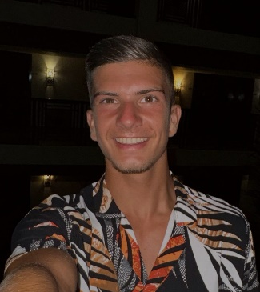
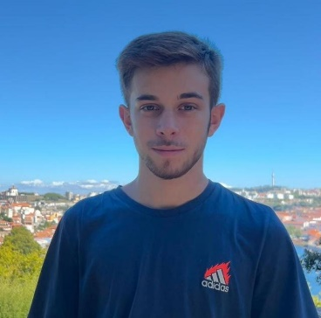
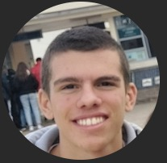
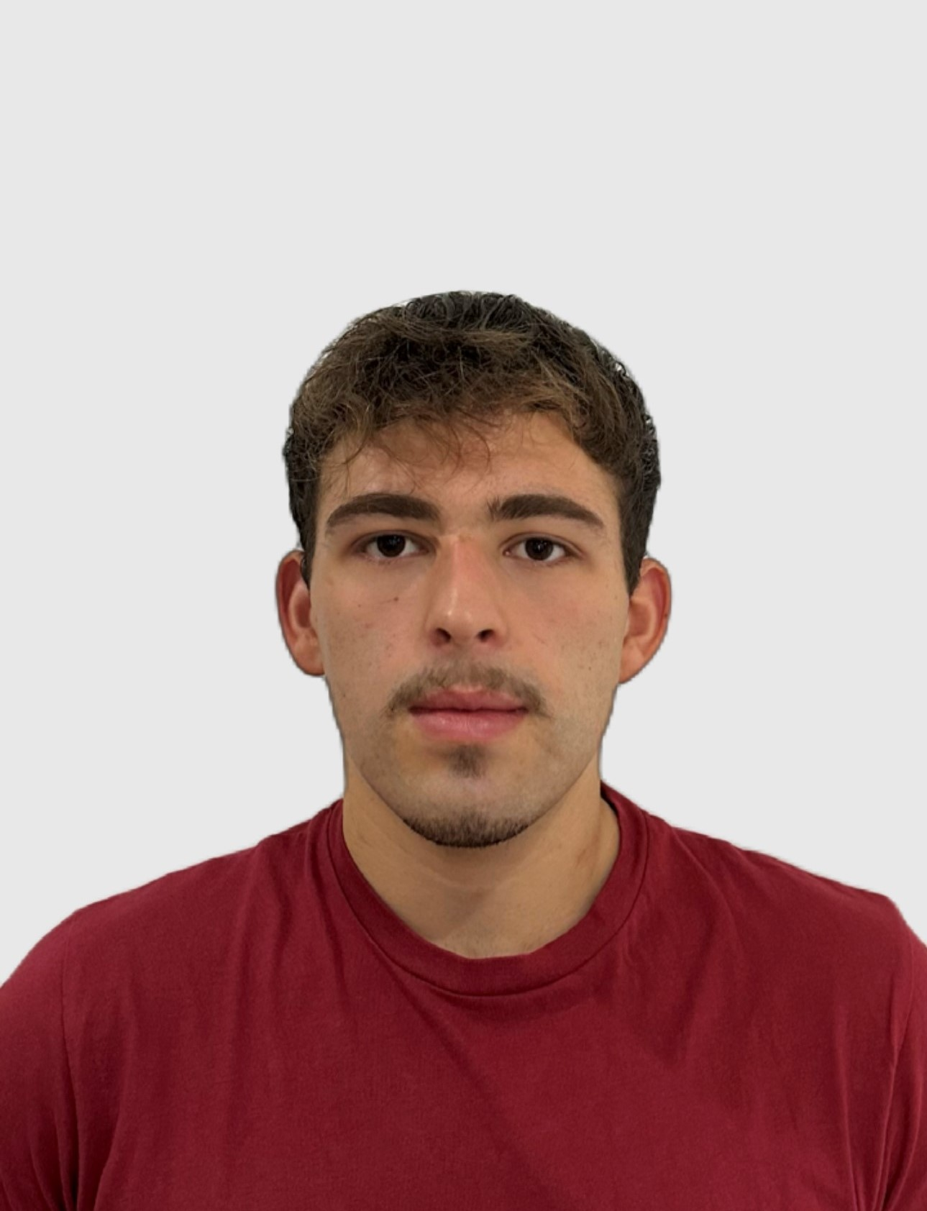
Class 2DC2DD Group 41 SPRINT 2
LAPR3 2024_2025
Group members:
Igor Coutinho (1230543) | Daniel Silva (1231046) | Rafael Barbosa (1230544) | David Vieira (1230487)

Slide 2
Sprint planning – Sprint 2
Planned Start Date: 28/10/2024 Real Start Date: 28/10/2024
Planned Finished Date: 24/11/2024 Real Finish Date: 24/11/2024
SPRINT BACKLOG
Number of stories | 32
Number of bugs | 0 (found so far)
Number of tasks | 41
Number of Management Tasks (Scrum) | 32
Number of team members | Planned: 4 Actual: 4
Total planned estimation vs execution | Planned hours: 150 Executed hours: 144

Slide 3
Sprint planning
Assignment US (as stated on project assignment) | Commited? (Yes / no according to team planning) | Todo | Doing | Testing | Done | Blocked
USBD 10 | Yes |  |  |  | x
USBD 11 | Yes |  |  |  | x
USBD 12 | Yes |  |  |  | x
USBD 13 | Yes |  |  |  | x​
USBD 14 | Yes |  |  |  | x​
USBD 15 | Yes |  |  |  | x​
USBD 16 | Yes |  |  |  | x​
USBD 17 | Yes |  |  |  | x​
USBD 18 | Yes |  |  |  | x​
USEI 08 | Yes |  |  |  | x​
USEI 09 | Yes |  |  |  | x​

Slide 4
Sprint planning
Assignment US (as stated on project assignment) | Commited? (Yes / no according to team planning) | Todo | Doing | Testing | Done | Blocked
USEI 10 | Yes |  |  |  | x
USEI 11 | Yes |  |  |  | x​
USEI 12 | Yes |  |  |  | x​
USEI 13 | Yes |  |  |  | x​
USEI 14 | Yes |  |  |  | x​
USEI 15 | Yes |  |  |  | x​
USLP 03 | Yes |  |  |  | x​
USLP 04 | Yes |  |  |  | x
USPL 05 | Yes |  |  |  | x
USAC 01 | Yes |  |  |  | x
USAC 02 | Yes |  |  |  | x

Slide 5
Sprint planning
Assignment US (as stated on project assignment) | Commited? (Yes / no according to team planning) | Todo | Doing | Testing | Done | Blocked
USAC 03 | Yes |  |  |  | x
USAC 04 | Yes |  |  |  | x
USAC 05 | Yes |  |  |  | x
USAC 06 | Yes |  |  |  | x
USAC 07 | Yes |  |  |  | x
USAC 08 | Yes |  |  |  | x
USAC 09 | Yes |  |  |  | x
USAC 10 | Yes |  |  |  | x
USFA 01 | Yes |  |  |  | x
USFA 02 | Yes |  |  |  | x

Slide 6
Work by team member

Slide 7
Work by type

Slide 8
Issues / Assumptions / unanswered questions
Description | Responsible | Date / sprint | Related issue / item in Git

Slide 9
Daily Meetings
Date | Place / duration | Daniel | David | Igor | Rafael
29/10/2024 | 15min, ISEP | x | x | x | x
31/10/2024 | 20min, ISEP | x | x | x | x
04/11/2024 | 15min, ISEP | x | x | x | x
06/11/2024 | 15min, ISEP | x | x | x | x
08/11/2024 | 20min, Class | x | x | x | x
11/11/2024 | 15min, ISEP | x | x | x | x
13/11/2024 | 15 min, ISEP | x | x | x | x
15/11/2024 | 20 min, Class | x | x | x | x
16/11/2024 | 20 min, Online | x | x | x | x
18/11/2024 | 15 min, ISEP | x | x | x | x
20/11/2024 | 15 min, ISEP | x | x | x | x
21/11/2024 | 20 min, ISEP | x | x | x | x
22/11/2024 | 20 min, Class | x | x | x | x
23/11/2024 | 15 min, Online | x | x | x | x
24/11/2024 | 15 min, Online | x | x | x | x

Slide 10
LLM performance assessment (chatGPT)
Source file (include file as attachment):
Input (prompt) :
Consider the development of a Sprint in a SCRUM environment with several user stories. Write a brief paragraph on each team member's performance, considering the work completed and reported in the attached file.
Then, provide an assessment of the team's overall performance in the project development, assigning a rating from 1 to 5, where 1 represents the lowest rating and 5 the highest.

Slide 11
LLM performance assessment
Output file (include file as attachment):
Output (one line per team member):
Igor: Throughout the Sprint, Igor demonstrated strong technical skills and a consistent approach to problem-solving. He worked on several key tasks, such as developing search functionalities, collaborating with Rafael on various user stories, and managing hardware integration for sensor monitoring. His focus on troubleshooting and supporting the team with system issues was valuable. However, he encountered challenges with task prioritization and understanding certain aspects of hardware and software integration. Overall, he maintained a positive attitude and made significant contributions to project development.
Daniel: Daniel actively participated in structuring the project and was heavily involved in the development of production trees, AVL trees, and the implementation of various user stories. His communication skills were valuable in clarifying problems with the team and ensuring everyone was aligned. He also faced difficulties with understanding certain flows and passing tests but continued to provide guidance and feedback to others. Daniel kept a focused approach, but at times, his individual work led to less interaction with the team.
David: David contributed consistently to the project, particularly in updating and structuring the relational and conceptual models. He worked diligently on transforming the models to different levels (conceptual, relational, and physical) and addressed challenges related to database structure and buffer logic. Despite some difficulties with a lack of information in earlier stages, David maintained a steady pace and was instrumental in ensuring that the project’s database structure was aligned with the team's needs. His contributions helped keep the project on track, especially in areas requiring technical expertise.
Rafael: Rafael showed strong dedication to his tasks, particularly in working on user stories related to the database and communication with the professor and client for clarification. He handled complex tasks like USEI14 and made steady progress with implementing and testing the ARQCP user stories. Despite encountering challenges with task organization and critical paths, Rafael remained proactive, seeking help when needed and ensuring he stayed aligned with the project’s goals.
Opinion about the output: We consider the output to be reasonably in line with what was developed during the sprint.

Slide 12
Sprint Retrospective
Date: 24/11/2024
What went well?
The project progressed successfully due to strong team collaboration, effective communication, and a clear division of tasks. We met deadlines consistently, delivering high-quality, functional solutions that aligned with client expectations. Challenges were handled efficiently, demonstrating adaptability and problem-solving skills.
What went wrong?
At times, we had very different viewpoints on how to approach certain aspects of the project. However, by listening to each other, we were able to reach a consensus.
What we’ve learned?
Throughout the project, we gained a deeper understanding of the importance of effective planning and communication for successful teamwork. We developed the ability to adapt quickly to changing requirements and overcome challenges through collaboration and creative problem-solving.

Slide 13
Sprint Retrospective
Date: 25/10/2024
Action items:
Continue to communicate and respect each other's different viewpoints.

Slide 14
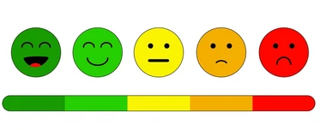
Overall Project perfomance:
Comments:
The team demonstrated effective collaboration, despite individual challenges. They communicated well, addressed technical issues efficiently, and maintained a focus on meeting deadlines. However, at times, there were difficulties with aligning individual work with the overall project vision, particularly in the earlier stages. Overall, the team showed growth in handling complex tasks and demonstrated resilience in addressing obstacles.
LLM evaluation: 4
Our evaluation
1
2
3
4
5

Slide 15


